Slide 1
TOPIC A:
DATABASES
LESSON A-7
DATA TYPES & STAKEHOLDERS

Slide 2
AGENDA
Warm-up Question
Data Types Review
Justifying Data Types
Stakeholders
Practice
Data Type Roulette
NOTE!
Have a way to take notes available for this lesson

Slide 3

THE WARM UP QUESTION
Take the following database table and convert it to 3NF (Third Normal Form)
EmpID | EmpName | Phone | Projects | HoursWorked
101 | Tom John | 555-1001 | Website, Database | 20, 15
102 | Tom Chen | 555-1002 | Mobile App | 35
103 | Tom Rick | 555-1003 | Website, Mobile App | 10, 25

Slide 4
THE WARM UP ANSWER
EmpID | EmpName | Phone
101 | Tom John | 555-1001
102 | Tom Chen | 555-1002
103 | Tom Rick | 555-1003
ProjectID | Project
1 | Website
2 | Database
3 | Mobile App
EmpID | ProjectID | HoursWorked
101 | 1 | 20
101 | 2 | 15
102 | 3 | 35
103 | 1 | 10
103 | 3 | 25

Slide 5
DATA TYPES REVIEW
What data type would you use to store a phone number in a system?

Slide 6
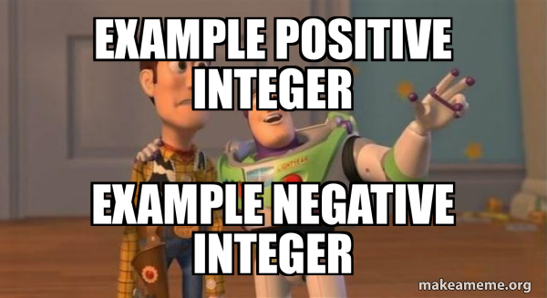
INTEGERS
Integer – used for storing whole numbers
Numbers/Large Number data types in Access
What are some examples of this?

Slide 7
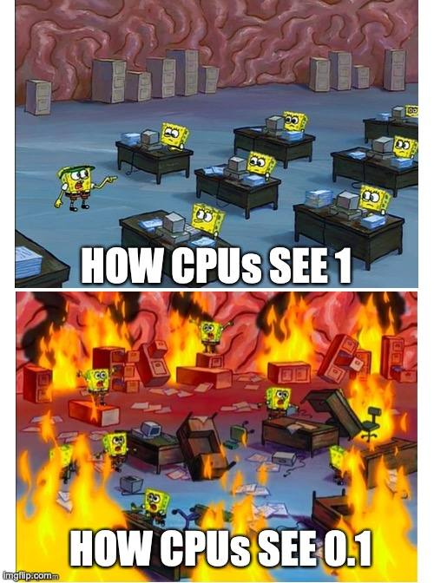
DOUBLES/FLOATS/DECIMALS
Doubles/Floats/Decimals – used for storing numbers with decimal places
Numbers/Large Numbers in Access
These are much less efficient than integers internally
What are some examples of this?

Slide 8
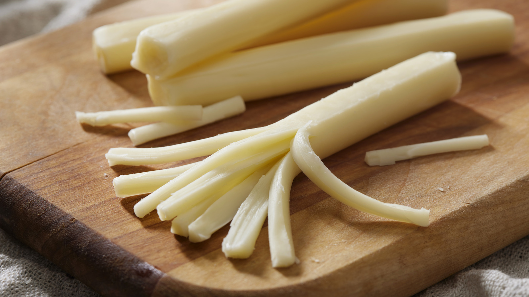
STRINGS
Strings – used for storing numbers with decimal places
Short Text/Long Text in Access
VARCHAR when detailing schema
Maximum length specified
What are some examples of this?

Slide 9
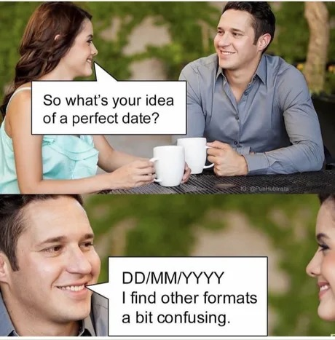
DATE/TIME
DateTime – used for storing date and time in a database (shocker)
Date/Time or Date/Time Extended in Access
You can change if it’s storing mainly the date or the time, and how that information is presented (digits for months, or words) using the format dropdown below the data type dropdown
What are some examples of this?

Slide 10
CURRENCY
Currency – used for storing monetary values (shocker)
Currency in Access
Can change type of currency and how it’s represented using format dropdown
What are some examples of this?

Slide 11
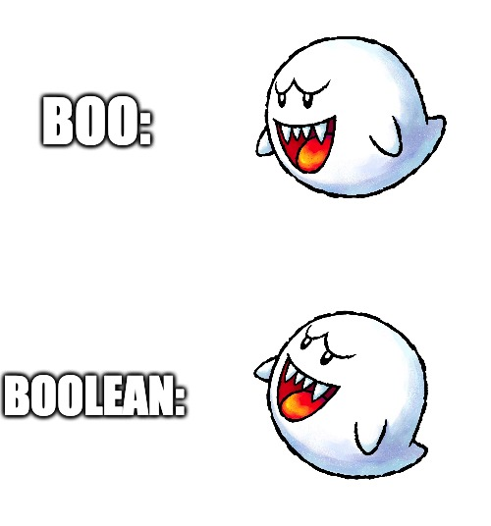
BOOLEAN
Boolean – stores a True/False value and nothing else
Yes/No in Access
Can change format to True/False or On/Off
What are some examples of this?

Slide 12
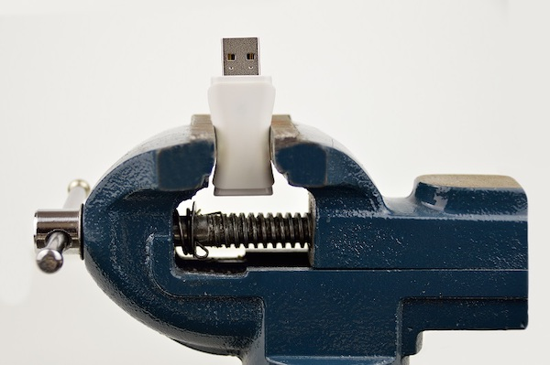
BLOBS
BLOBS – Short for Binary Large Objects
This is the attachments data type in Access
This is how we store files inside a database such as images

Slide 13
SCENARIO
Imagine yourself as the owner of an online forum
To sign up for an account, legally, the user must be 13 years or older
Should you store their birthdate as a Date/Time to check this, or their age as an integer?
Why?

Slide 14
SCENARIO
If you’re storing student grades, would you store this as a percentage, or as a GPA decimal?
Which takes up more space?
Which is more accurate?

Slide 15
SCENARIO
What if you run a social media site?
Consider the differences between storing images as BLOBs in a database, vs storing them on a server and pulling them using a link
What do you think the upsides/downsides are to these approaches?

Slide 16
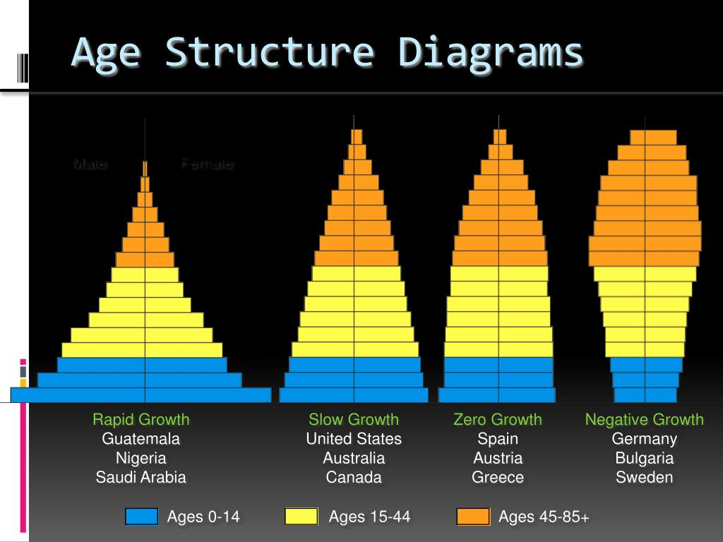
PRIVACY
What privacy concerns may arise depending on how we store data types?
Lets’ revisit the date of birth vs age discussion for a forum earlier

Slide 17
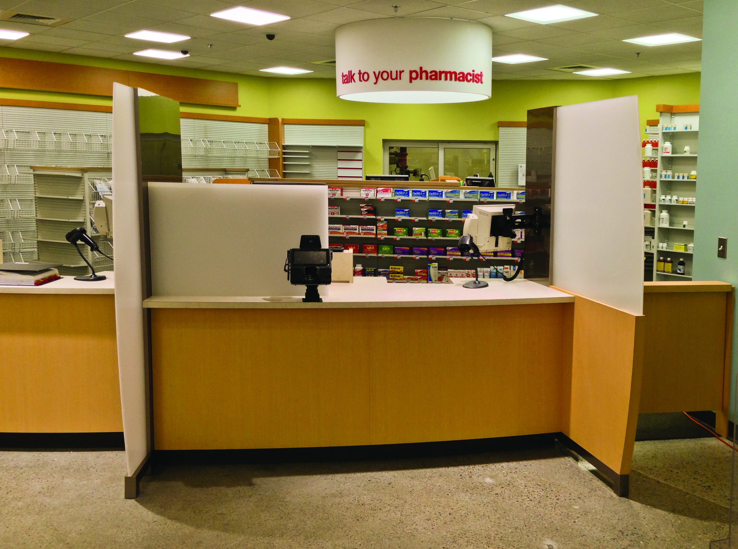
PRIVACY
Someone’s date of birth is often identifying information, especially alongside their name
If you make a pickup from a pharmacy, that’s really all you need

Slide 18
PRIVACY
What about storing somebody’s full salary vs their salary range?
First off, full salary likely takes up more space than range split off into its own table
What else is a consideration?

Slide 19

PRIVACY
Even something as simple as storing someone’s full name vs storing their initials can make the difference between a catastrophic and an inconvenient data breach
What are the consequences of somebody’s name getting leaked?

Slide 20
PRIVACY
However, we of course can’t always use the most secure information
What is an example where storing just somebody’s initials wouldn’t be sufficient?

Slide 21
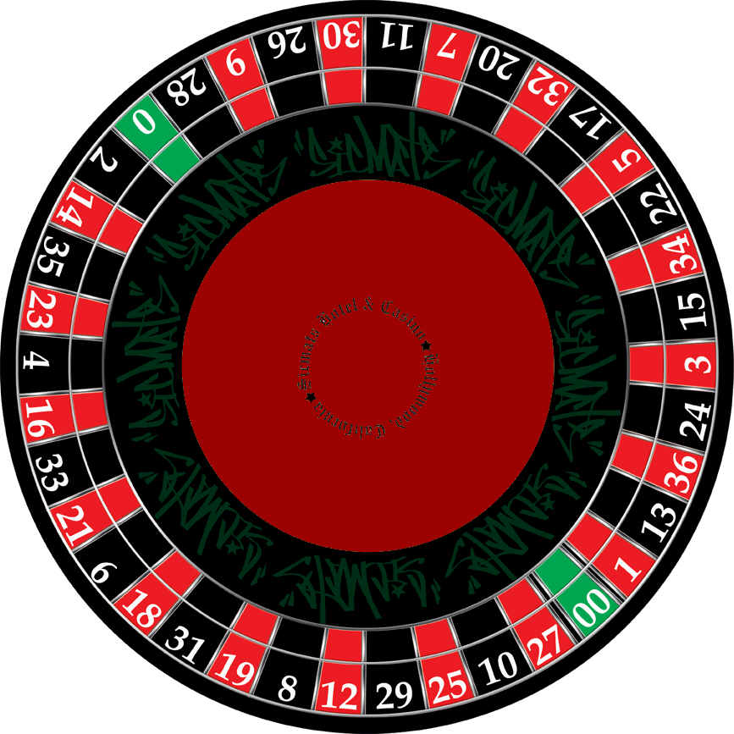
ROULETTE
And now it’s time to put our skills to the test on the…
DATA
TYPE
ROULETTE

Slide 22
ROULETTE
What data type would be best to store this attribute?
AGE

Slide 23
ROULETTE
What data type would be best to store this attribute?
PHONE NUMBER

Slide 24
ROULETTE
What data type would be best to store this attribute?
HOURLY WAGE

Slide 25
ROULETTE
What data type would be best to store this attribute?
IF FEES ARE PAID

Slide 26
ROULETTE
What data type would be best to store this attribute?
BOOK COVER IMAGES

Slide 27
ROULETTE
What data type would be best to store this attribute?
STUDENT GPA

Slide 28
ROULETTE
What data type would be best to store this attribute?
DELIVERY DATES

Slide 29
ROULETTE
What data type would be best to store this attribute?
BIRTH DATE

Slide 30
ROULETTE
What data type would be best to store this attribute?
STUDENT ID

Slide 31
ROULETTE
What data type would be best to store this attribute?
FLIGHT SEAT NUMBERS (LIKE 12A)

Slide 32
ROULETTE
What data type would be best to store this attribute?
BANK ACCOUNT BALANCE

Slide 33
ROULETTE
What data type would be best to store this attribute?
ITEM STOCKED STATUS

Slide 34
ROULETTE
What data type would be best to store this attribute?
SONG DURATION

Slide 35
ROULETTE
What data type would be best to store this attribute?
PLAYER HEIGHT

Slide 36
ROULETTE
What data type would be best to store this attribute?
HOME ADDRESS

Slide 37
ROULETTE
What data type would be best to store this attribute?
DAILY STEP COUNTER

Slide 38
ROULETTE
What data type would be best to store this attribute?
MOVIE RELEASE YEAR

Slide 39
ROULETTE
What data type would be best to store this attribute?
EMAIL ADDRESS

Slide 40
ROULETTE
What data type would be best to store this attribute?
GPS LOCATION

Slide 41
ROULETTE
What data type would be best to store this attribute?
HAS ALLERGY

Slide 42
ROULETTE
What data type would be best to store this attribute?
USERNAME

Slide 43
ROULETTE
What data type would be best to store this attribute?
NUMBER OF LIKES

Slide 44
ROULETTE
What data type would be best to store this attribute?
CREDIT CARD NUMBER

Slide 45
ROULETTE
What data type would be best to store this attribute?
TASK START TIME

Slide 46

THE WINNER IS…

Slide 47

VOCAB TO REMEMBER
Integer
Boolean
Float
Double
Decimal
Blob
Date/Time

